Slide 1
Steam Recommender System
Presented by Charles Pan
Notes:
Hi, I’m Charles Pan and today I introduce to you my Steam Recommender System; but first of all, what is Steam?

Slide 2


01
Arguably the best video game digital distribution service
Notes:
Steam is one of the largest game distribution service loved and known by almost every gamer.
Mostly, similar to how Netflix is known for movies or TV-shows; Steam is known for digital game distribution and killing GameStop.

Slide 3
How Does This Steam Recommender System Work?
Input Game
Input # of Recs
Review the Recommendations
1
2
3
Notes:
I have built a Content Based Recommender System where the user just inputs the game and
The number of recommendations they would like to receive
And afterwards, the recommender system will output all the recommendations as similar to the inputted game.

Slide 4
The Workings
Notes:
It’s pretty simple how it works, so lets quickly see what’s under hood on what the system is built off of

Slide 5
Data Sources
Steam
58983 Entries/Rows (Games)
39 Columns (Features)
Steam Spy
56623 Entries/Rows (Games)
20 Columns (Features)
Notes:
Using data queries and API, I extracted data from the two sources.
Steam releases an API for others to delve in, and SteamSpy is a Steam stats service based on Web API which gathers data from Steam User Profiles
From there, I thinned it the merged information to 16 thousand games and 12 features.
Removing games that have almost no reviews and ones with too many faulty entries.

Slide 6
Features Chosen
01
02
Categories
Genres
03
04
Tags
Misc
Notes:
The Major Features Chosen in our Content Recommender System are Categories, Genres, Tags, and Etcetera

Slide 7
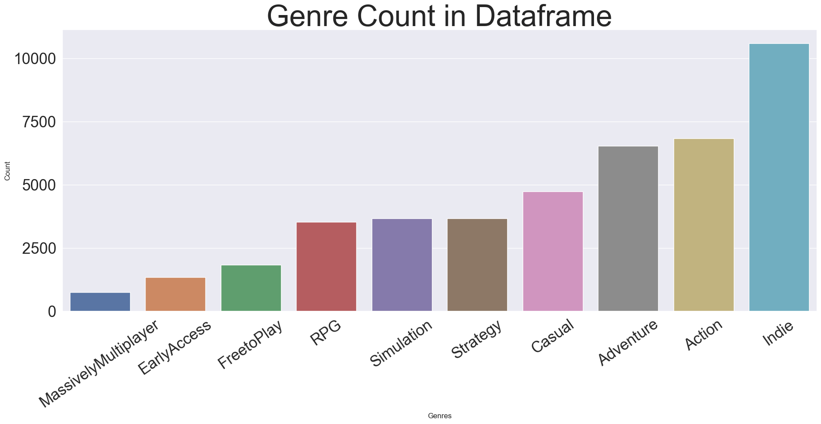
Genres
fig.savefig("./imagess/Genres.png")
Notes:
Genres refers to the game genre such as whether a game is Action like Mario, Strategy like Final Fantasy, or Adventure like Pokemon.

Slide 8
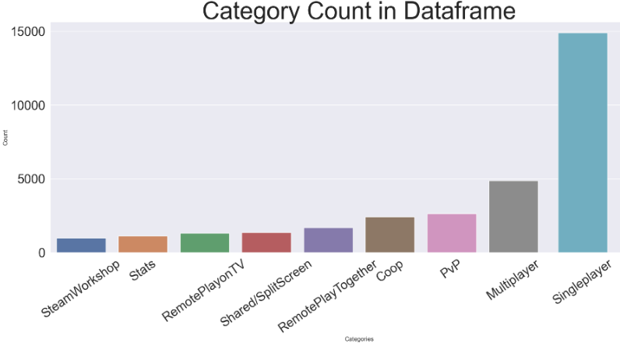
Categories
fig.savefig("./imagess/Genres.png")
Notes:
Categories is essentially short classification such as Single Player, Multiplayer, Pvp, Coop; key stuff gamers are looking for

Slide 9
Misc
fig.savefig("./imagess/Genres.png")
Developers
Price Point
Sentiment
Publishers
Tags
Popularity
Notes:
Tags are random things gamers have put on a game which SteamSpy picked up on.
You’ll find stuff like Gothic, Dungeon Crawler, Isometric, and other random shenanigans in this
Developers and Publishers are key components for creating and releasing/managing a game.
The other two are pretty self explanatory.

Slide 10
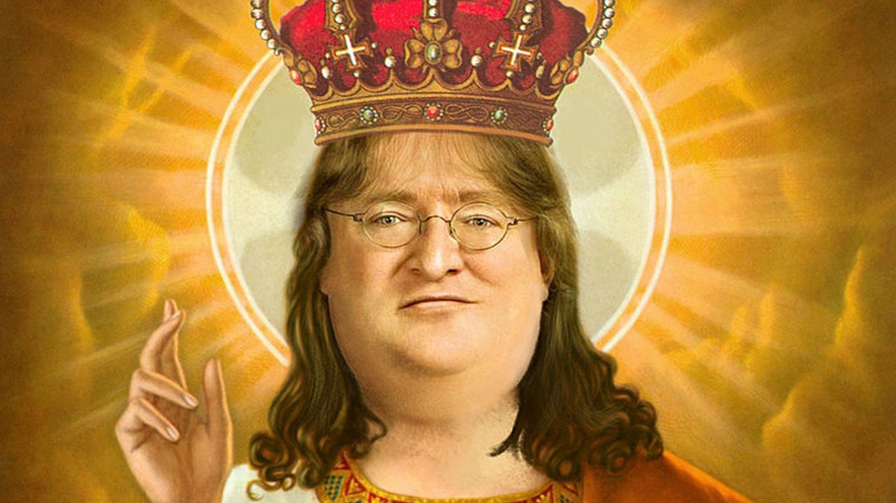
We Run It Live
(By live I mean local)

Slide 11
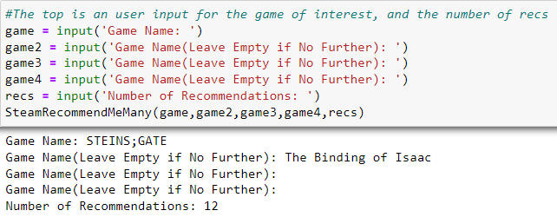
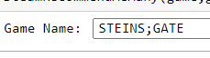
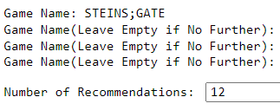
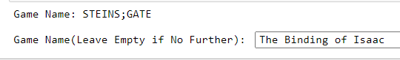
Data Entry
Notes:
Essentially, you just have to input game names, and the number of recommendations you would like to see

Slide 12
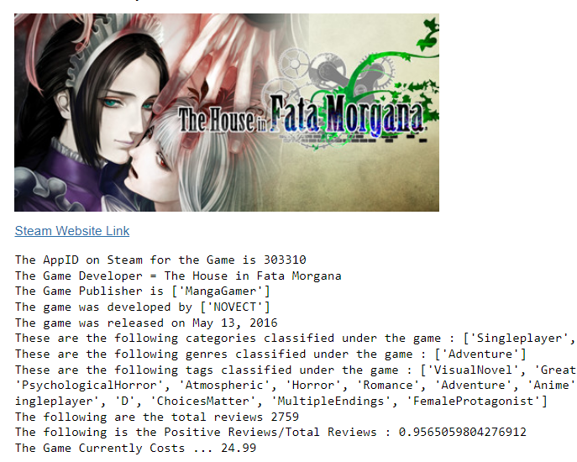
Recommendation Output
Notes:
The recommendation outputs an image from steam, a website link, and all the details in a formulaic format; this recommendation ties closely to STEINS;GATE
As both are psychological visual novels.

Slide 13
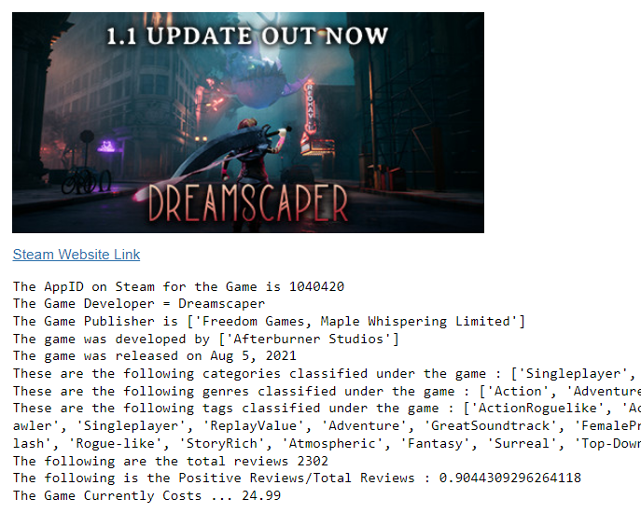
Recommendation Output
Notes:
This is another recommendation based off the data entered and this would tie more closely with The Binding of Isaac as both are single player RogueLikes.

Slide 14
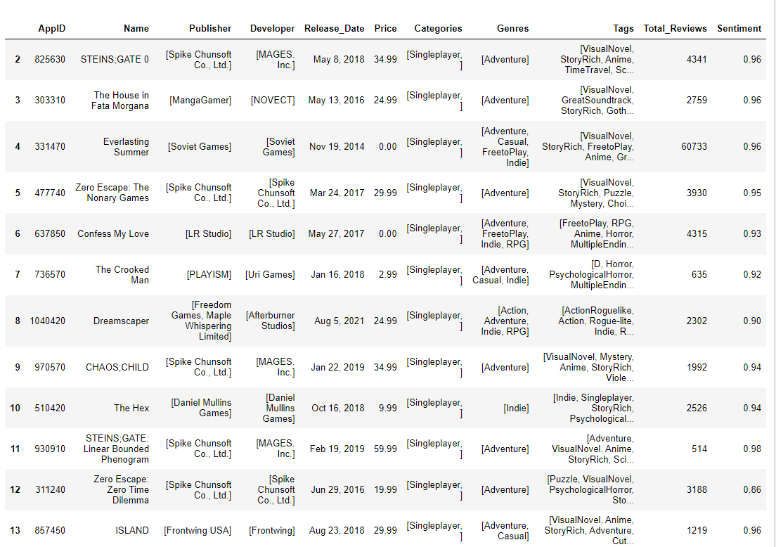
Recommendations
Notes:
This is another recommendation based off the data entered and this would tie more closely with The Binding of Isaac as both are single player RogueLikes.

Slide 15
Next Steps
Create a Steam Profile Extractor to use and create more recommendations based off of someones Steam profile.
Create a collaborative based recommender system to offer different options for users.
Do a recommender system based off review words (NLP) to flex
Notes:
The next steps would be to create a steam profile extractor which is supported by steam API to query someones library and wishlist and provide recommendations from there.
It would also be nice to build a collaborative based recommender system as to offer another option of choices provided by Recommender System.

Slide 16
THANKS!
Do you have any questions?
Email: charlesmpan@gmail.com
Github: www.github.com/charlesmpan
Linkedin: www.linkedin.com/in/charles-pan-
Please keep this slide for attribution
Notes:
Thanks for coming, any questions?

